Slide 1

’’EMPOWERMENT THROUGH TECHNOLOGICAL EXCELLENCE” GENBA SOPANRAO MOZE TRUST’S 25/1/3, Balewadi, Haveli, Pune-411045 GENBA SPOANRAO MOZE COLLEGE OF ENGINEERING, BALEWADI, PUNE -45
Project Presentation (B.E. Mech.)
TITLE: DESIGN AND TESTING OF LIGHT WEIGHT SANDWICH COMPOSITE T- JOINT USING FINITE ELEMENT ANALYSIS
PROJECT GUIDE: PROF. S.S.YADAV
PROJECT MEMBERS: RUTURAJ HODAGE (B150300844)
ABHISHEK TEKWADE(B150300938)
MAHESHWARI KHILLARI(B150300868)
ATHARVA BHANGE(B150300811)

Slide 2
Introduction:
Modern Mechanical Structures Uses Composite T – Joint Due Excellent Mechanical Properties.
The Widely Used T – Joint Materials Such As Steel And Aluminum Have Major Problem Of Corrosion.
To Overcome This Problem They Are Replaced By Composite Materials As Glass Fabric, PVC Foam And Epoxy Resin.
Many Of The High-performance Components In Aircraft And Spacecraft Industry Are Made Of Honeycomb Sandwich Materials. These Composite Parts Are Fabricated With Glass Or Carbon-fiber Reinforced Face Sheets And A Thick Low-density Core. Their Superior Mechanical Properties, In Particular The Unique Stiffness To Weight Ratio, Make Them A Favorable Material In Aviation Applications.

Slide 3
Objective
To Overcome The Problems Of Steel And Aluminum.
We Can Make Use Of The Following Composite Materials Which Has:
High Strength To Weight Ratio
High Corrosion Resistance
Low Maintenance
Cost Efficient
It is important to understand the way a composite t-joint fails and develop methods of improving fatigue life performance to enhance the durability of Mechanical Structures.
To replace the material which are used in our daily life components to enhance the durability and to benefit the products economically.

Slide 4
What are Composite Materials?
A composite material is a combination of two materials with different physical and chemical properties.
Metal and its alloys.
Metal Alloys and organic polymers.
Ceramic and organic polymers.
Why use Composites?
Weight saving is one of the main reasons for using composite materials rather than conventional materials for components.
While composites are lighter they can also be stronger than other materials.
The global composite material market is segmented by resin, fiber type, coatings, adhesives, end-user industry, and geography. By resin, the market is segmented into Thermoset Resin and Thermoplastic Resin. By fiber type, market is segmented into Glass Fiber, Carbon Fiber, Aramid Fiber, and Others.

Slide 5
Composite Materials:
RESIN | Thermosets | Polyester Vinyl Esters Phenolic Cyanate Ester Others
 | Thermoplastics | Polyetherimide(PEI) Polyether ketone(PEK) Polyamide-imide(PAI) Liquid Crystal Polymer(LCP) Others
FIBER TYPES | Glass Fiber Carbon Fiber Aramide Fiber
ADHESIVES | Epoxies Bismaleimide (BMI) Modified Acrylics Polyurethanes Silicones

Slide 6
Literature Survey:
To understand the present practices and theories testing of T-Joint composite material.
To obtain a better understanding of how the material property will affect on bending, compressive and tensile forces.
Based upon which selection and characterization of composite material with respect to their performance will be done.
A number of scientific and technical issues still need to be resolved, for example, predictive FE models for determining the strength of composite t-joints have not been satisfactorily developed.
Following is the detail review of comparison between various reasearch papers based upon some parameters:

Slide 7
REFERANCE | MAIN PURPOSE OF STUDY | CRITERIA CONSIDERED | REMARK
A.P. Mouritz, E.Gellert, P.Burchill, K.Challis | A wide range of new application of composites to naval vessels are described | Growing use of composites in the complete constructions of fast petrol boats mine hunting ships and corvettes is discussed | Composite structure are requuired to pass a series of strict regulatios relatong to air blast and underwater shock damage resisteanc, fire performance.
Keun Song, JI Young Choi, Jin Jwe Kweon, Jin Ho Choi,Kwamg Soo Kim | Pull out and Shear Failure loads of compositre sandwich,insert joint | 80 Specimen of different types were tested | Its failure was influenced by core height, density and face thickness
Byoung Jung Kim, Dai Gil Lee | Monocoque satellite structure ws designed to reduce structural mass and improve static and dynamic structural rigidity. | A new I Shaped side was insert and fixed into composite sandwich pannel edge with film adhesive flatwise compressive and tensile test was performed. | Mass reduction of 14.8 kg , Launching Cost reduction of $148000-$296000 from FEA satellite structure reliability was verified with a safety margin of 2.4
Jun Cao, Joachim L. Grenested, William J. Maroun | A Hybrid ship hull made of steel truss & composite sandwich skins was investigated experimentally and numerically. | 6m model was tested under hogging load after being subjected to sagging, loads were introduced as shear, model was designed to the design load point at which plstic yielding of steel truss. | Good Correlation wass found after comparing data of both sagging and hogging.
Harald Osnes, Dag McGeorge | To improve performance of High speed Aircraft. Strength of doubled lap steel, composite joint are investigated through theoritical analysis and expirement testing. | Strength was measured expirementally, a new elastic plastic analysis accounting of deformation has been derived | Prediction using new theory derived compared with reported result, strength prediction obtained by new theory agree well with the expirimental result compared to old theory.
E.W. Andrews, N.A. Moussa | Failure mode maps for sandwich panels with composite face sheets are presented. | Sandwich panel was considered modeled as a single DOF mass spring system to include dynamic effects in problem. | Comparision with some quasi static test result was performed where expieimental data was consistent with analysis.
Rodrigo A. Silva Munoz, Roberto A. Lopez Anido | Structural health monitoring of marine composite structural joints using embedded Fiber Bragg Grating (FBG) Sensor. | Joints were subjected to fatigue tension loading to induce stable crack propogation. A Finite Analysis model was develop to correlate expiremental strain measurements with numerical predictions. | A Strain based methodology can be utilized to detect crack propogation in this type of composite joint.
H.C.H. Li, I. Herszberg, C.E. Davis, A.P. Mouritz, S.C. Galea | Structural health monitoring of marine composite structural joints using Fiber Optic Sensor. | Finite element modelling indicate presence of this bond and strain distribution. A technique is developed based on novel Signal Processing and statistical outlier detection. | It provides successful damage diagnosis with an acceptable level of accuracy more accuracy may be achieved by increasing the sensor density.
Jin Dai, H. Thomas Hahn | Static and fatigue behaviour of vacuum assisted resin transfer molding sandwich panels under flexural loading. | Stresses in the face and core at failure where calculated from failure loads, for short beams core failure lead to failure of beam as whole, in long beams failure of wood core would be contained until the face failed. | A good similarity was seen between the static and fatigue failure modes for both short span and long span specimens.
Dana M. Elzey, Aarash Y.N. Sofla, Haydn N.G. Wadley | Change in shape of multifunctional structural acutator panel undergoing significant load. | No external forces are required to complete the full cycle of shape change, panel is able to perform fully reversible cyclic shape changes by altering heating on face sheet. | The performance of sandwich panel in terms of of mechanical as well as physical factors can be optimised by proper selection of face sheet material and its thickness
Vincent Caccese, Jean Paul Kabche, Keith A. Berube | Implement a watertight hybrid connection concept that provides access using removable panels on a ship hull. | Various hybrid joints with various geometries are loaded in flexure to quantify performance | Joints with metal cap plates can be made stronger and rotationally stiffer than standard bolted joints for resisting bending load
C. Douthe, J.F. Caron, O. Baverel | Gridshell structure in glass fibre reinforced polymer are presented and loaded. | Results of the experimental tests are compared to numerical results of a non-linear analysis done with the dynamic relaxation method. | The instantaneous behaviour of composites in large rotations proved to be linear elas tic until break so that the elements can be considered as linear elastic during the whole erection process.
P. Bunyawanichakul, B. Castanie, J.J. Barrau | The types of failure and non- linearrties are analysed by conducting the pull-out test on the representative samples. | For each modes of failure, local experimental and numerical analysis are carried out. | This first damage is due to the transverse shear cracking of the resin. A second loss of 75% of the initial stiffness happens due to maximum shear strain

Slide 8
Material Properties:
Parameters | Glass Fabric | PVC Foam | Epoxy Resin
Material | Glass Reinforced Plastic (GRP) | PVC ( Poly Vinyl Chloride) | Epoxide (Polymeric Material)
Advantage | High resistance to bending, tensile, compressive forces. High humidity and temperature Resistant. Resistant to chemical and biological effect. | Water Resistant. Corrosion Resistant. Fire Resistant. High Strength and durability. Easily Shaped and Painted. | High Mechanical properties. Easy Processing. Low shrinkage. Good addition. High corrosion Resistance.
Disadvantage | warpage, low weld, and knit line strength, higher viscosity of melt, and low surface quality | Flammable, poisonous gas after combustion, Material strength is poor, prone to crack ,insulation shedding | relatively high cost, long curing time, and handling difficulties.
Application | bows and crossbows, translucent roofing panels, automobile bodies, hockey sticks, surfboards, boat hulls, and paper honeycomb | Used for the ceilings of Cars, Buses or Trains | adhesive purposes, for Coatings and Sealant,
Cost | Rs 480 / sq mt | Rs 400 / sq mt | Rs 650 / kg

Slide 9
Design of T-Joint
According to above theories discussed in literature survey following conclusions can be made. In order to construct a new design of composite T- joint based on above theories these conditions and criteria are consider.
1) Two plates either core A, B or Hull- Bulkhead assembly should be joint at 90 degree and some provision should be made to fix them at 90 degree (by groove or guide).
2) It should be a composite structure i.e. use of two or more material.
3) Over laminates or skin is provided for better strength against tension and to protect filler material in main adhesive bonding zone.
4) Minimum use of filler material or resin to make it light weight.
5) Good appearance and simplicity in handling.
6) Dimensions are round off so that manufacturing becomes easy.

Slide 10
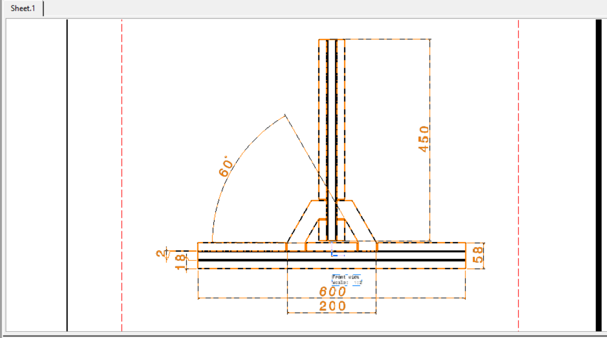
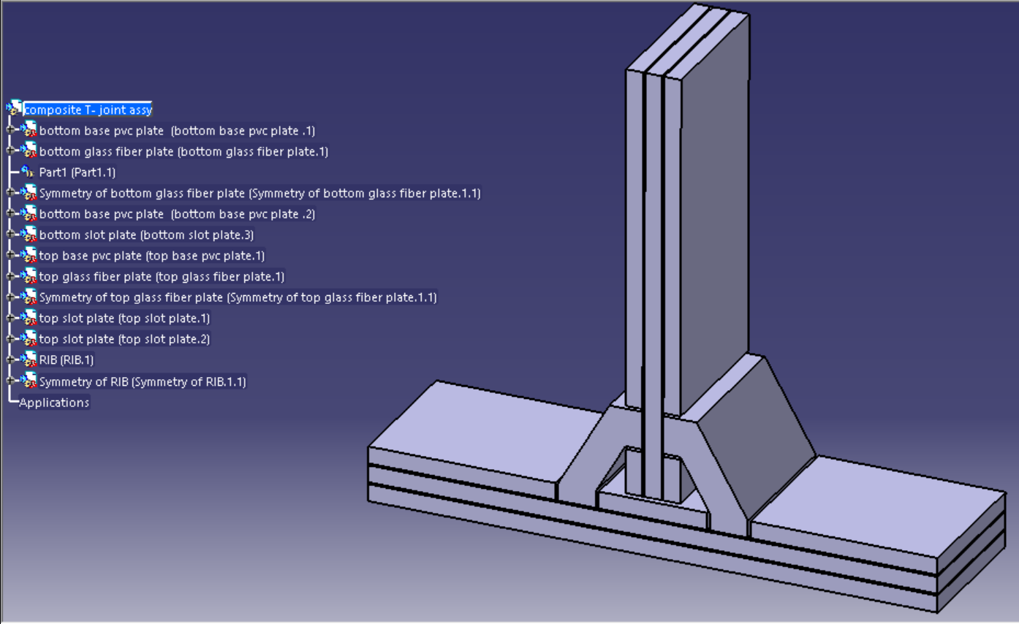
2D & 3D Structure:
2D View
3D View

Slide 11
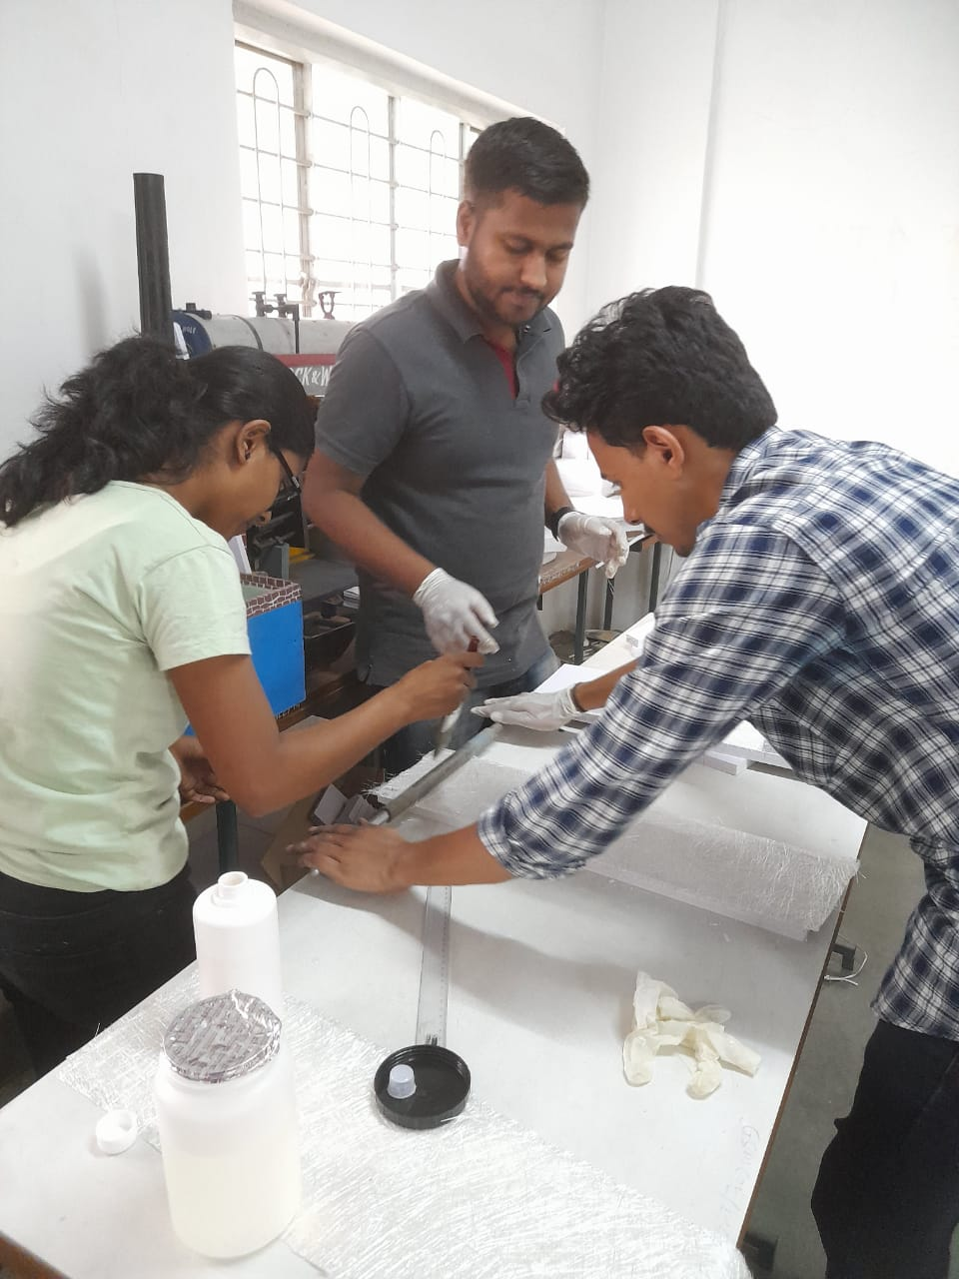
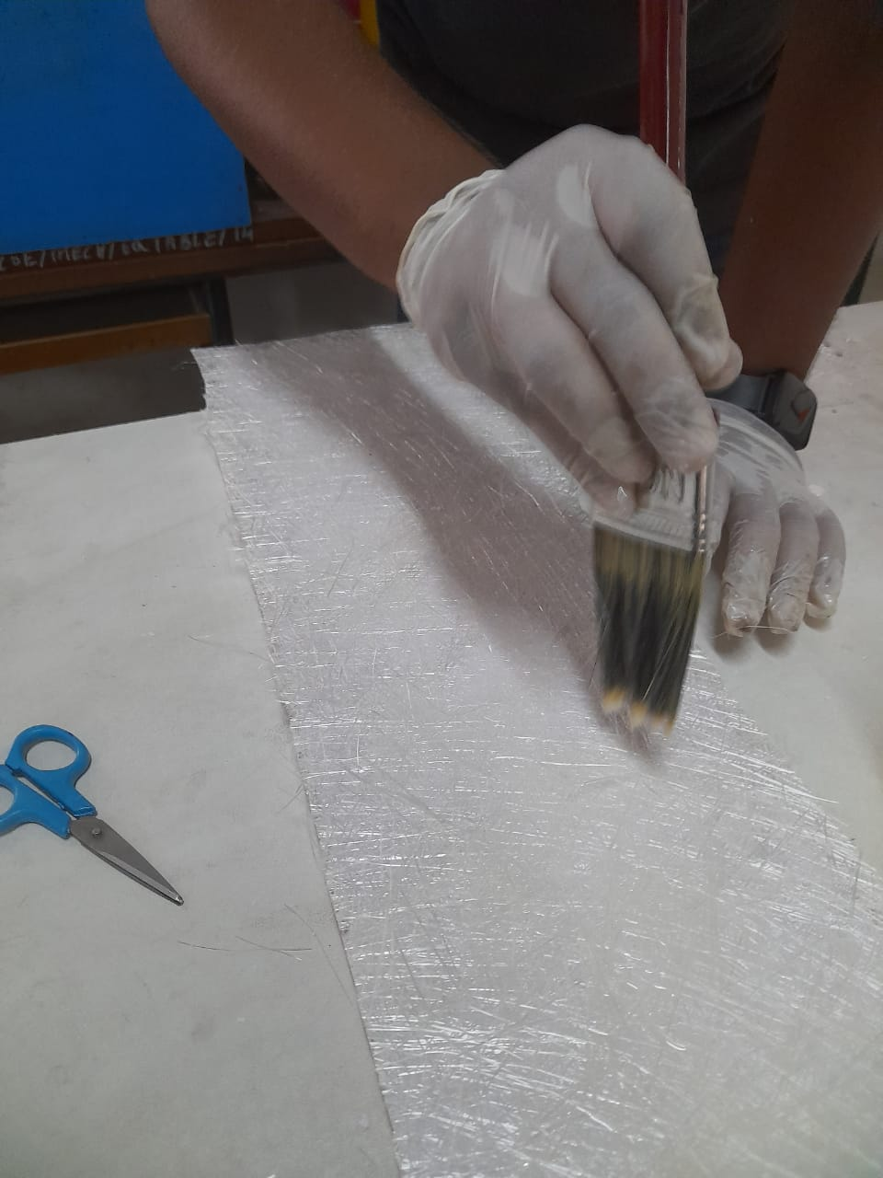
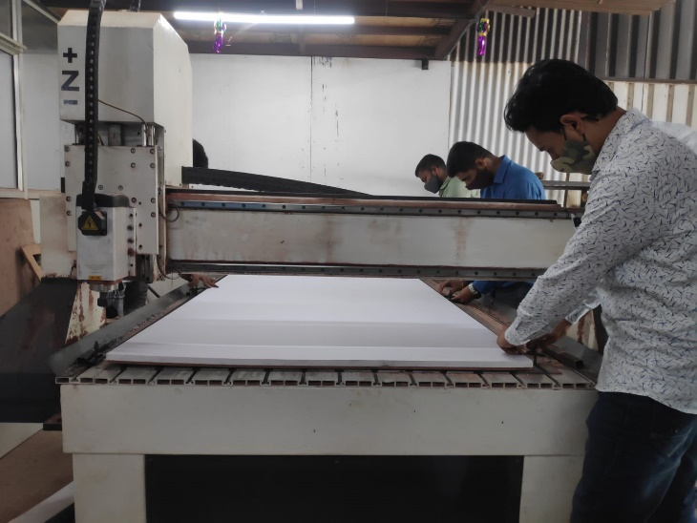
Manufacturing of T Joint
The manufacturing of T-joint will be carried out in college workshop to get guidance of workshop supervisor and project guide.
A T-joint consists of horizontal plate (hull), vertical plate (bulkhead), core pieces, filler triangle and overlaminates. Sandwich panels for T- joint are manufactured by HLU (Hand Lay-up) method. Since hull and bulkhead are made from core laminated with skin, it becomes quite difficult to understand and manufacture.

Slide 12
Analysis
By the finite element analysis, it is possible to understand the failure mechanisms associated with the complex structure of the T-joint by identifying the critical points and improving them.
Below fig. shows the distribution of the stresses at particular load application. The maximum value is located at the corner where there is a stress concentration.
The effects of changes in the T-Joint geometry (overlaminate angle and hull thickness) were studied by comparing the strain distribution in critical regions of the joint.

Slide 13
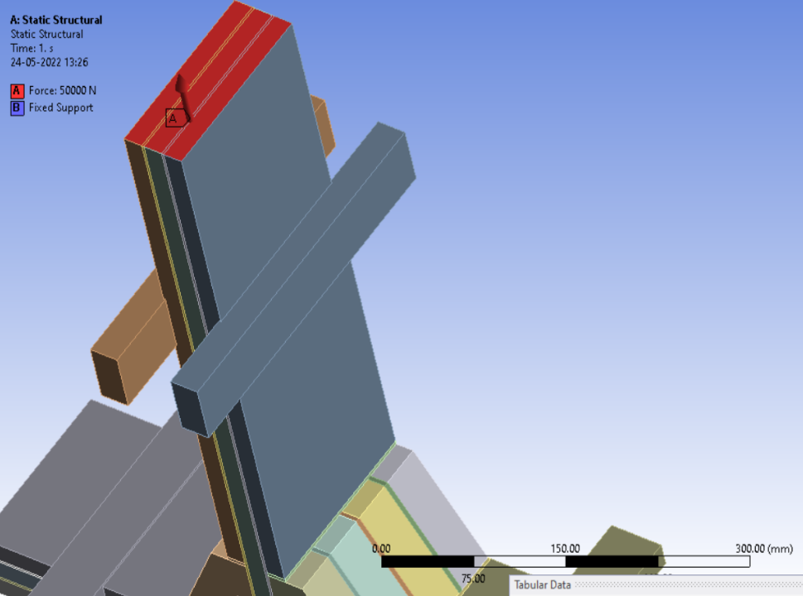
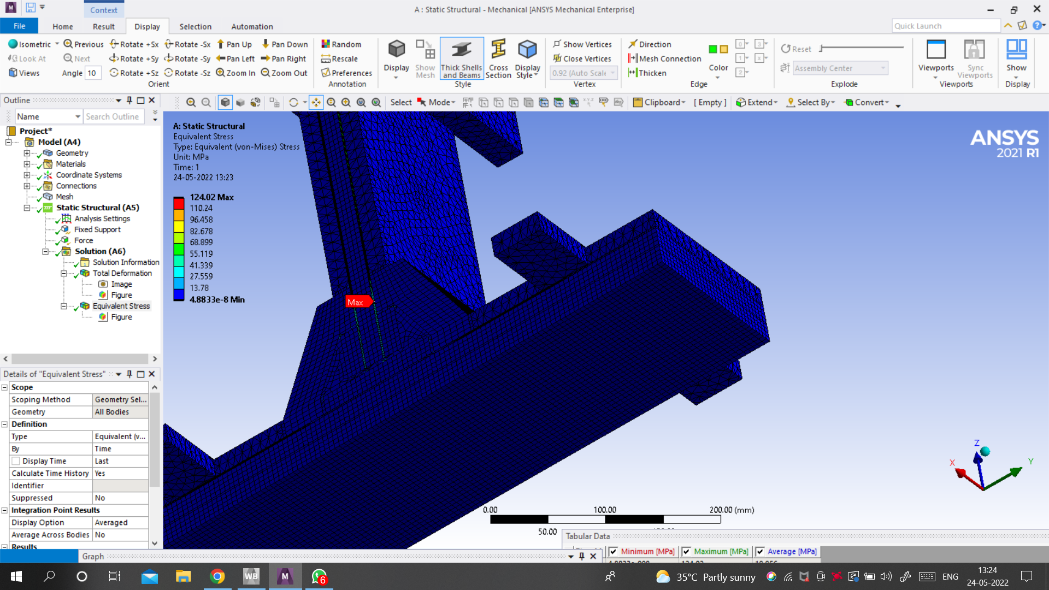
Sr. No. | LOAD APPLIED (KN) | TOTAL DEFORMATION (mm) | STRESS (MPa)
1 | 20 | 4.85 | 49.607
2 | 30 | 7.96 | 74.411
3 | 50 | 11.32 | 124.02

Slide 14
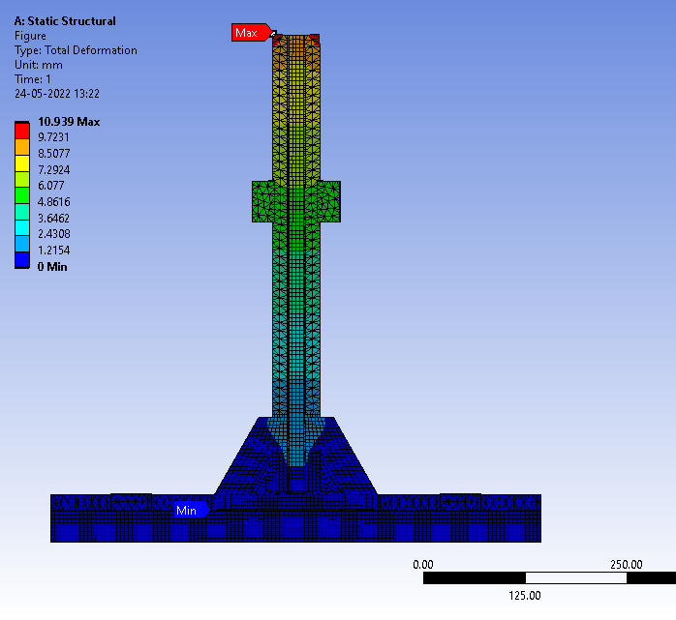
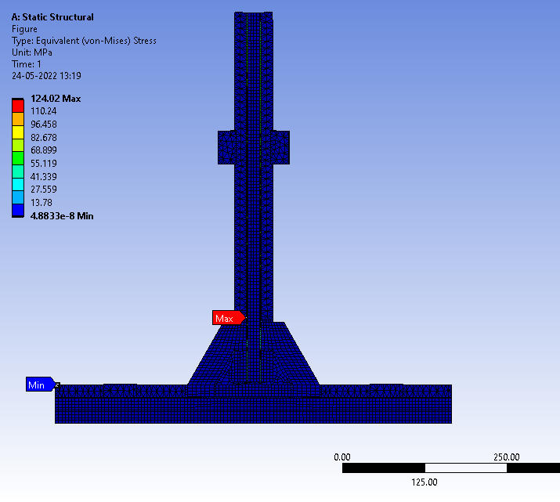
Analysis of T- Joint its Deformation and Stress Generation:

Slide 15
Experimental Analysis
We are determining the static tensile load and displacement of a T-joint with the help of stress analysis.
We have studied the strength and failure mode experimentally and by finite element analysis. Load Vs Displacement curves plotted with the help of servo hydraulic testing machine.
After building the structure, it’s good practice to verify the FEM using experimental stress analysis.
We are using experimental stress analysis also FE analysis. In this case, the goal is to identify the crack an existing t-joint in order to resolve problems.

Slide 16
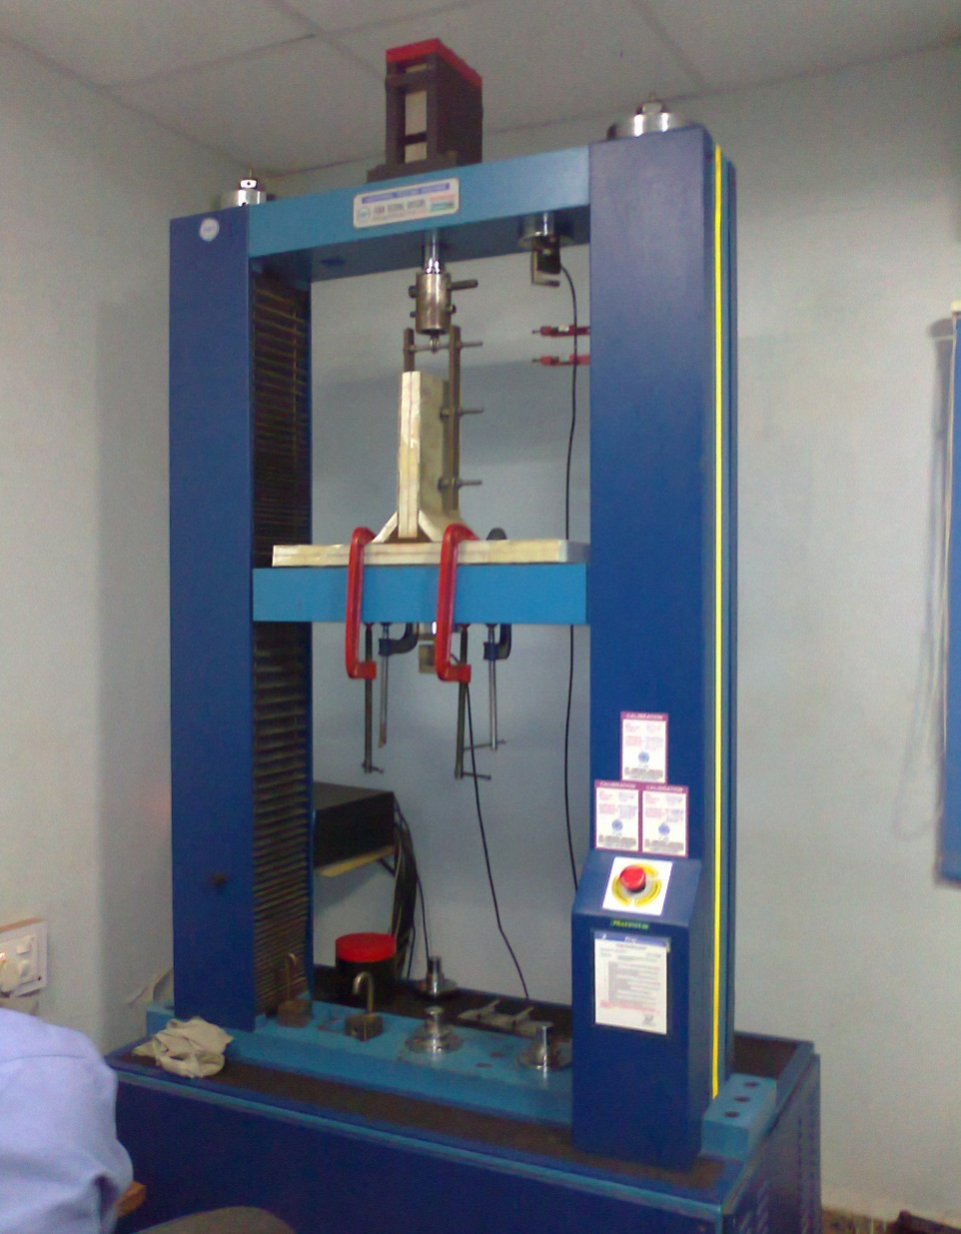
Value | Unit | Sample-45deg | Sample-60deg
Failure load | KN | 29.8 | 49.5
Deformation | mm | 7.96 | 11.32
Tensile Stress | N/mm² | 91.37 | 125.30

Slide 17
Result
The crack initiated from the interface between the over laminate and bottom skin through core A at about 49.5 KN after 10.93 mm displacement. The load versus displacement curve is shown in fig.
SR. NO. | LOAD (in KN) | ANSYS RESULT (in mm) | EXPERIMENTAL RESULT (in mm)
1 | 20 | 4.85 | 4.32
2 | 30 | 7.96 | 7.25
3 | 50 | 11.32 | 10.45
According to Finite Element Analysis result, maximum stress has developed on over laminate and bottom skin. Hence it was obviously failed at high stress region i.e. from over laminate.

Slide 18
Conclusion
It is found that both hull thickness and over laminate angle affected the critical strains in both the over laminate hull, indicating that in the design of such joints, these effects must be considered.
The selected sandwich T-joint has been tested in static tension in special designed fixture .
The T-joint fails in shear in the core of the base panel at a load of 49.5 KN.
The release of energy from the shear failure of the base panel causes the T-joint itself to fail as well.
The failure load of new T-joint is nearly 20% higher than that of the reference Base Design T- joint.
The failure mode is initiated from overlaminate to foam core A by shear failure.
The load Vs deflection curve is almost linear until a load of 49.5 KN.

Slide 19
Referance
REFERENCES:
1.D.W. Zhou and L.A. Louca “Numerical simulation of sandwich T-joints under dynamic loading” Composites Part B 39 (2008) 973–98520.
2.G. Di Bella, C.Borsellino “Experimental and numerical study of composite T-joints for marine application” international journal of adhesion & adhesives 30(2010) 347-358.
3.Jeom Kee Paik, Anil K.Thayamballi, Gyu Sung Kim “The strength characteristics of aluminum honeycomb sandwich panels” Thin-walled structures 35 (1999) 205-231
4.Elena Bozhevolnayaa and Ole T.Thomsen “Local effects across core junctions in sandwich panels” Composites: Part B 34 (2003) 509–517.
5.S.M.R. Khalili and A.Ghaznavi “Numerical analysis of adhesively bonded T-joints with structural sandwiches and study of design parameters” International Journal of Adhesion & Adhesives 31 (2011) 347–356.

